Slide 1
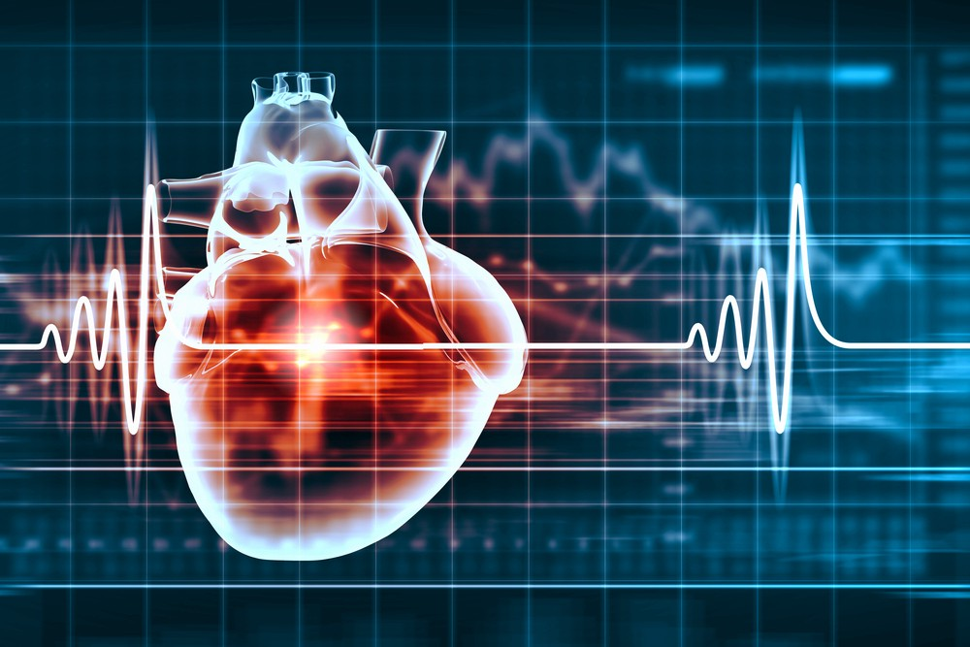
MAJOR PROJECT PRESENTATION
Web-Based Machine Learning Application
for Heart Disease Prediction
Presented by:
Praphooll Markndey (16111018)
Chandrika Rani Tudu (18111018)
Durgesh Kumar (18111023)
Jitendra Rathore (18111028)
MD Samar Siddiqui (18111035)
Prachi Dewangan (18111041)
Sarita Kanwar (18111047)
Surjeet Singh (18111053)
Guided By:
Dr. Neelam Shobha Nirala
Notes:
Links:
https://unsplash.com/photos/fzOITuS1DIQ

Slide 2
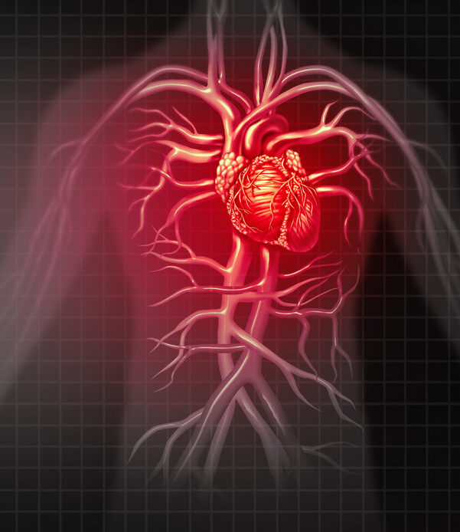
CONTENT
Introduction
Objective
Risk Factors
Dataset
Analysis Of Dataset
Methodology
Implementation In Real Life
Proposed System
Website and Mobile App
About Machine Learning
Types of ML
Algorithm(methods)
Advantage/Drawback
Conclusion
References
Notes:
Links:
https://unsplash.com/photos/fzOITuS1DIQ

Slide 3
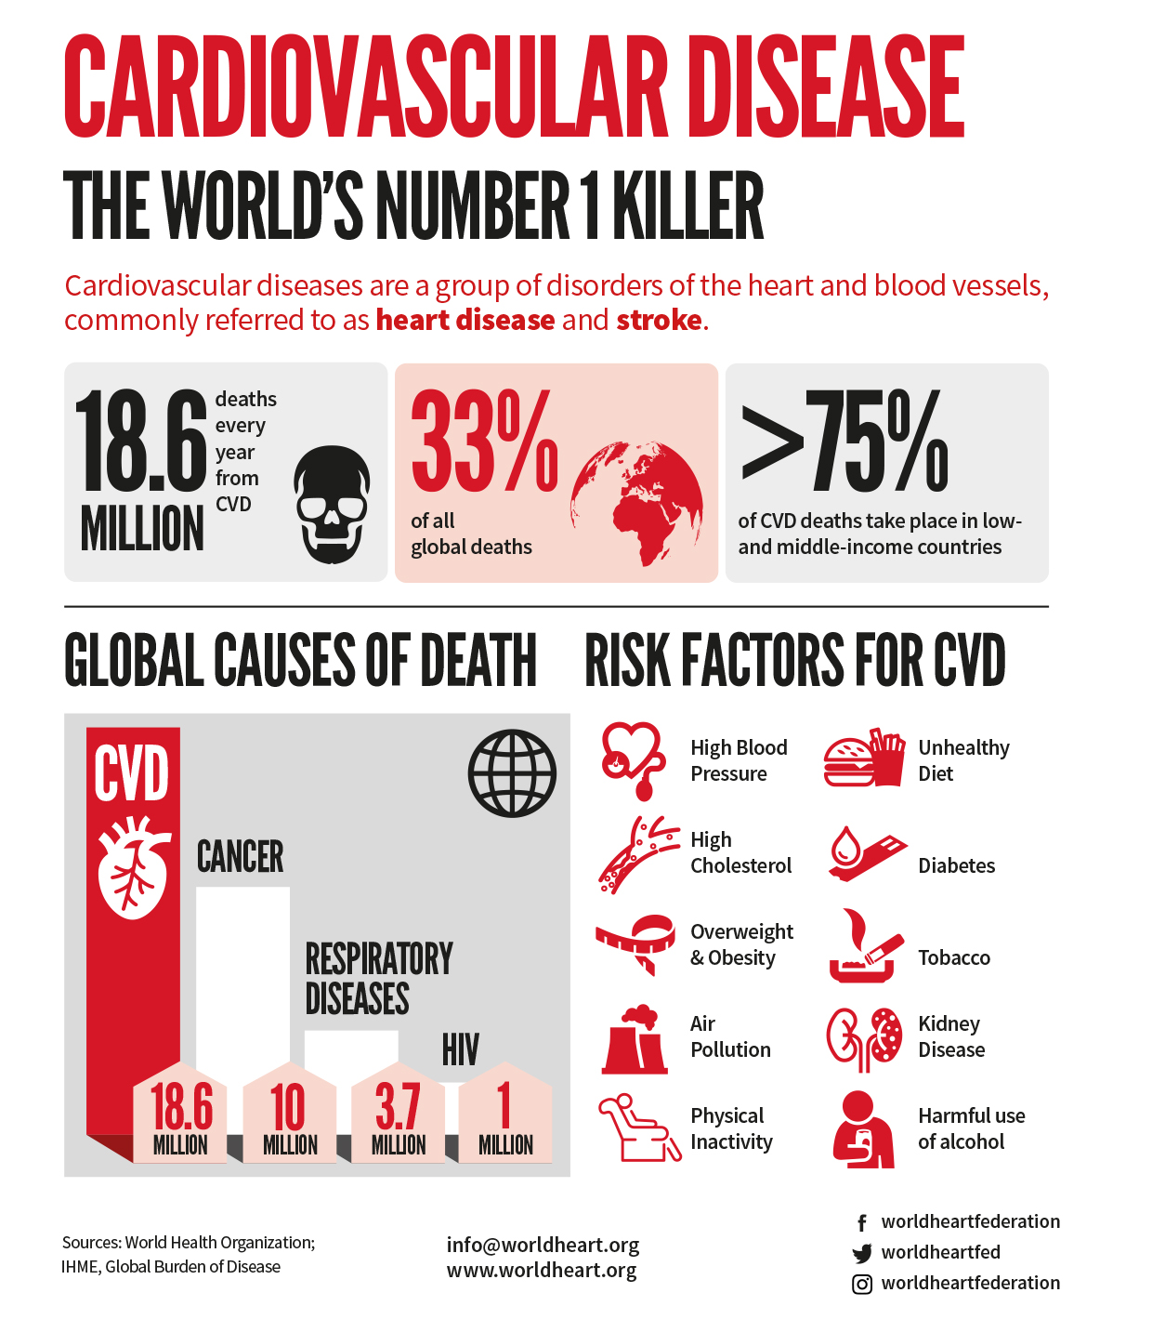
1. INTRODUCTION
Cardiovascular diseases (CVDs) are the leading cause of death globally.
An estimated 17.9 million people died from CVDs in 2019, representing 32% of all global deaths.
Several different symptoms are associated with heart disease, which makes it difficult to diagnose it quicker and better.
Heart disease is also referred to as a ”silent killer” because it causes death without causing noticeable symptoms.
Early detection of cardiac disease is critical for implementing lifestyle modifications in high-risk people and, as a result, reducing consequences.
This project tries to predict future heart illness by evaluating patient data and using machine-learning algorithms to classify whether they have heart disease or not.
Notes:
Links:
https://unsplash.com/photos/fzOITuS1DIQ

Slide 4
2. OBJECTIVE
The Heart Disease Prediction application is an end user support and online consultation project.
Lots of people living in village don't aware about the heart disease and if they are, they can't even afford the diagnostic charges.
Here, we propose a web application that allows users to get instant guidance on their heart disease through an intelligent machine learning system online.
Using the machine learning and low-cost portable devices (such as portable glucometer, cholesterol, ECG, BP , etc.) we are trying to solve this problem with the early prediction of heart disease so everyone can take precaution and save their life.
Attributes such as Age, Sex, CP, Trestbps, Chol, FBS, Rest ecg, Thalach, Exang, Oldpeak and Slope are fed into the machine learning algorithms which is used to predit risk of heart attack in a person.
Machine learning have ability to accurately predict that whether a person having heart disease or not and need cardiologist or not.
Notes:
https://unsplash.com/photos/fzOITuS1DIQ

Slide 5
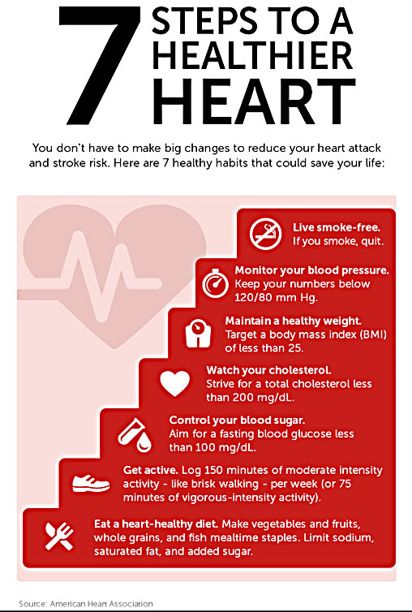
3. RISK FACTORS
Risk factors for developing heart disease include:
Age - Growing older increases your risk of damaged and narrowed arteries and a weakened or thickened heart muscle.
Sex - Men are generally at greater risk of heart disease. The risk for women increases after menopause.
Family history - A family history of heart disease increases your risk of coronary artery disease.
Smoking - Heart attacks are more common in smokers than in nonsmokers.
Diabetes - Diabetes increases your risk of heart disease. Both conditions share similar risk factors, such as obesity and high blood pressure.
High blood cholesterol levels - High levels of cholesterol in your blood can increase the risk of plaque formation and atherosclerosis.
Obesity - Excess weight typically worsens other heart disease risk factors.
Stress - Unrelieved stress may damage your arteries and worsen other risk factors for heart disease.
Notes:
Links:
https://unsplash.com/photos/fzOITuS1DIQ

Slide 6
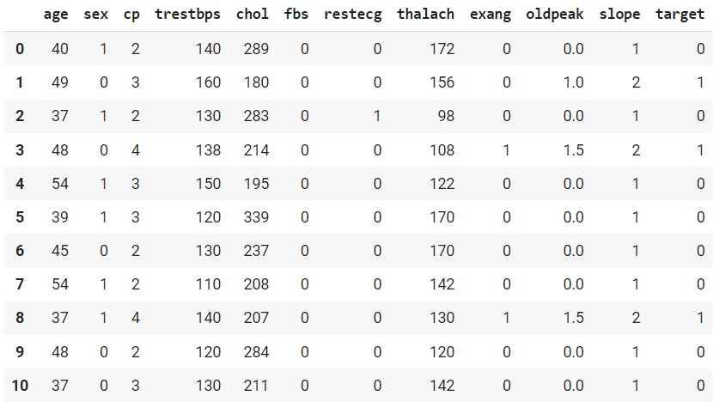
4 DATASET
This dataset consists of 12 attributes and 3235 rows.
Age: represent the age of a person.
Sex: describe the gender of person.
(0-Female, 1-Male)
CP: represents the severity of chest pain patient
is suffering.
Trestbps: resting systolic blood pressure.
Chol: It shows the cholesterol level of the patient.
FBS: It represent the fasting blood sugar in the patient.
Restecg: resting electrocardiograph results.
Thalach: shows the max heartbeat of patient.
Exang: used to identify if there is an exercise induced angina.
Oldpeak: describes patient’s depression level.
Slope: describes patient condition during peak exercise. It is divided into three segments.
Heart Disease Prediction Data Set
Notes:
Links:
https://unsplash.com/photos/fzOITuS1DIQ

Slide 7
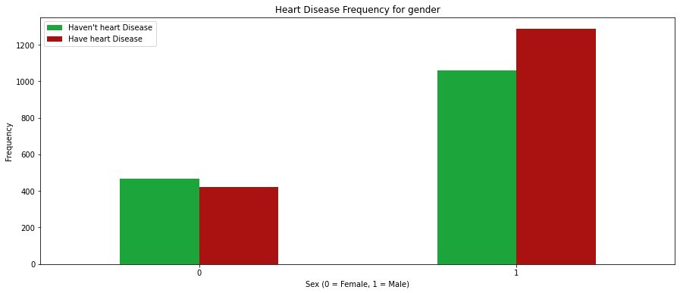
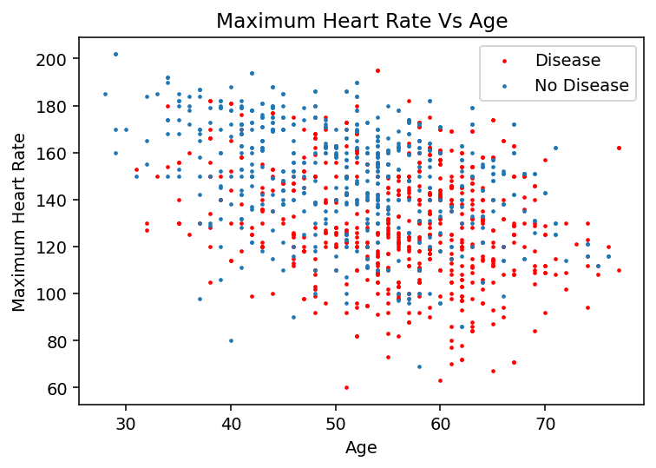
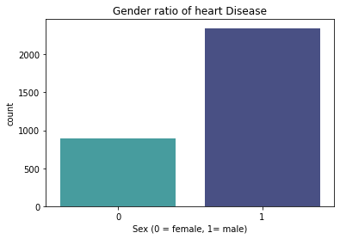
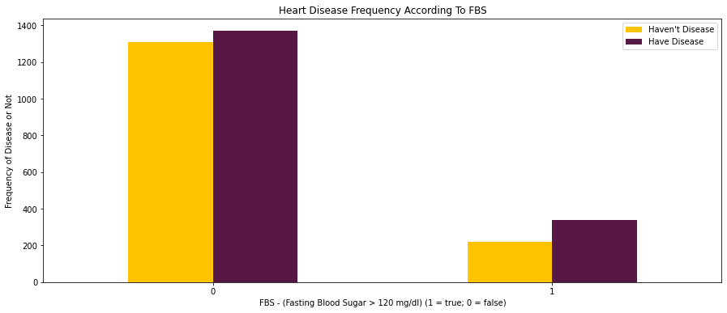
5 ANALYSIS OF DATASET
Notes:
Links:
https://unsplash.com/photos/fzOITuS1DIQ

Slide 8
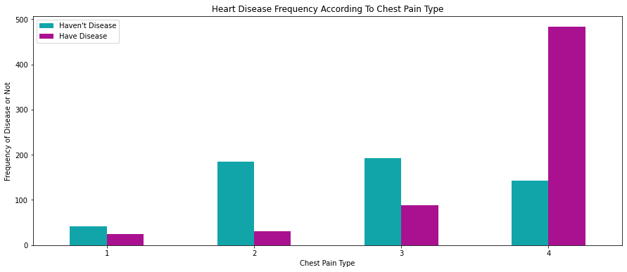
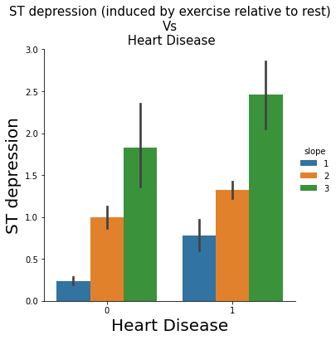
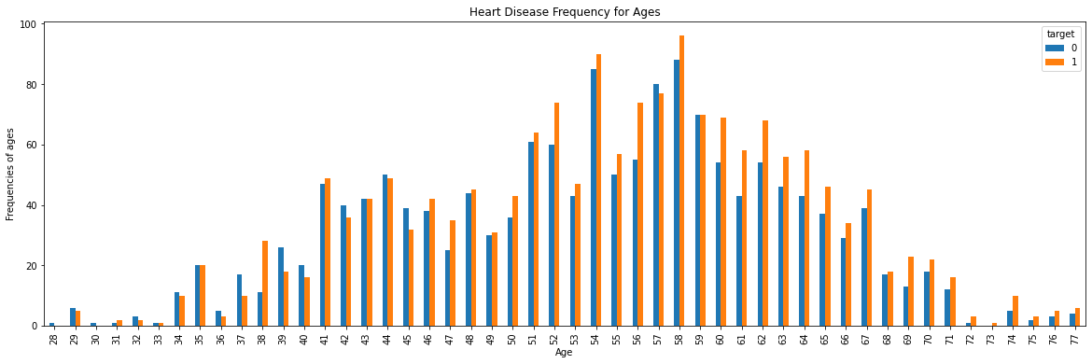
Notes:
Links:
https://unsplash.com/photos/fzOITuS1DIQ

Slide 9
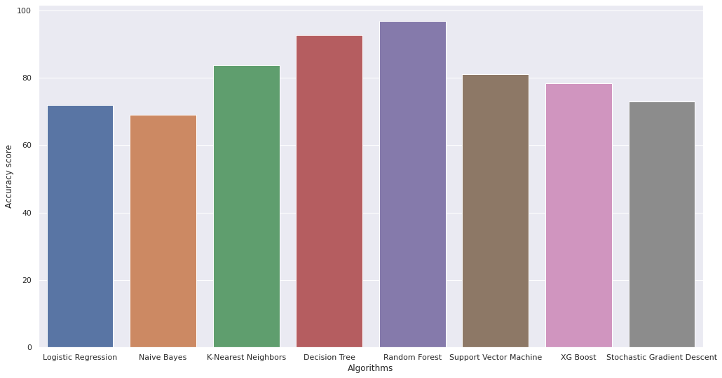
93.70%
91.17%
88.65%
85.71%
84.87%
96.75
86.55%
83.19%
84.03%
92.74
83.77
80.99
78.36
72.95
71.87
68.93
Notes:
Links:
https://unsplash.com/photos/fzOITuS1DIQ

Slide 10
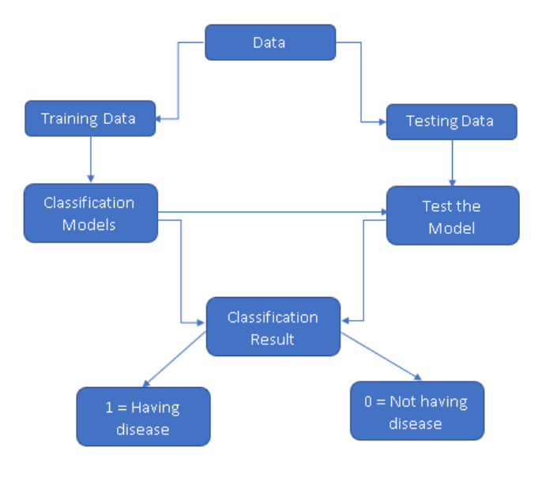
6. METHODOLODGY
The proposed work predicts heart disease by exploring the eight classification algorithms and does performance analysis.
objective of this study is to effectively predict if the patient having risk of heart disease.
The health professional enters the input values from the patient’s health report.
The data is fed into model which predicts the probability of having heart disease. Fig. shows the entire process involved.
Generic Model Predicting Heart Disease
Notes:
Links:
https://unsplash.com/photos/fzOITuS1DIQ

Slide 11
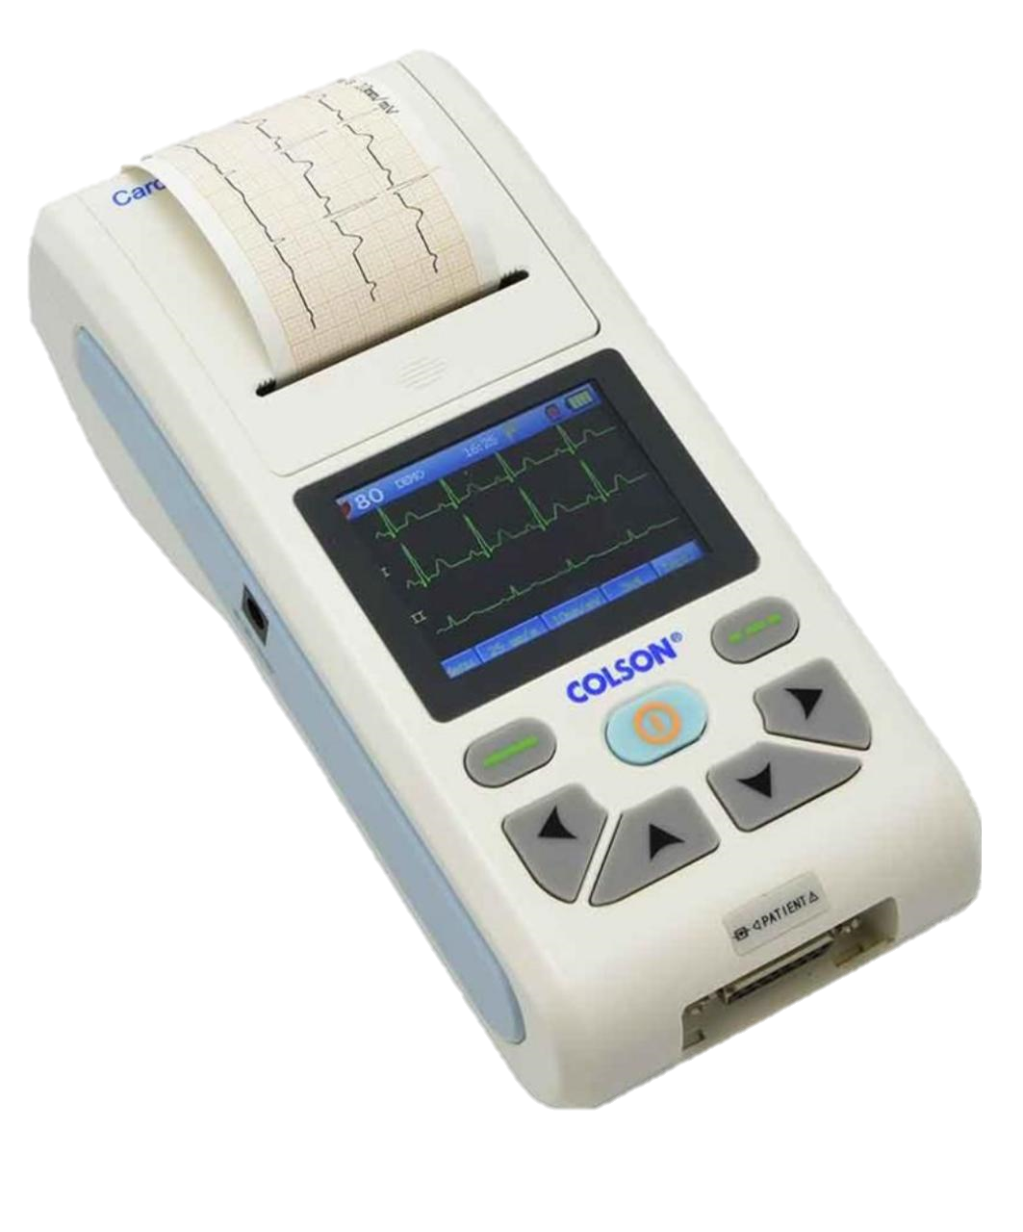
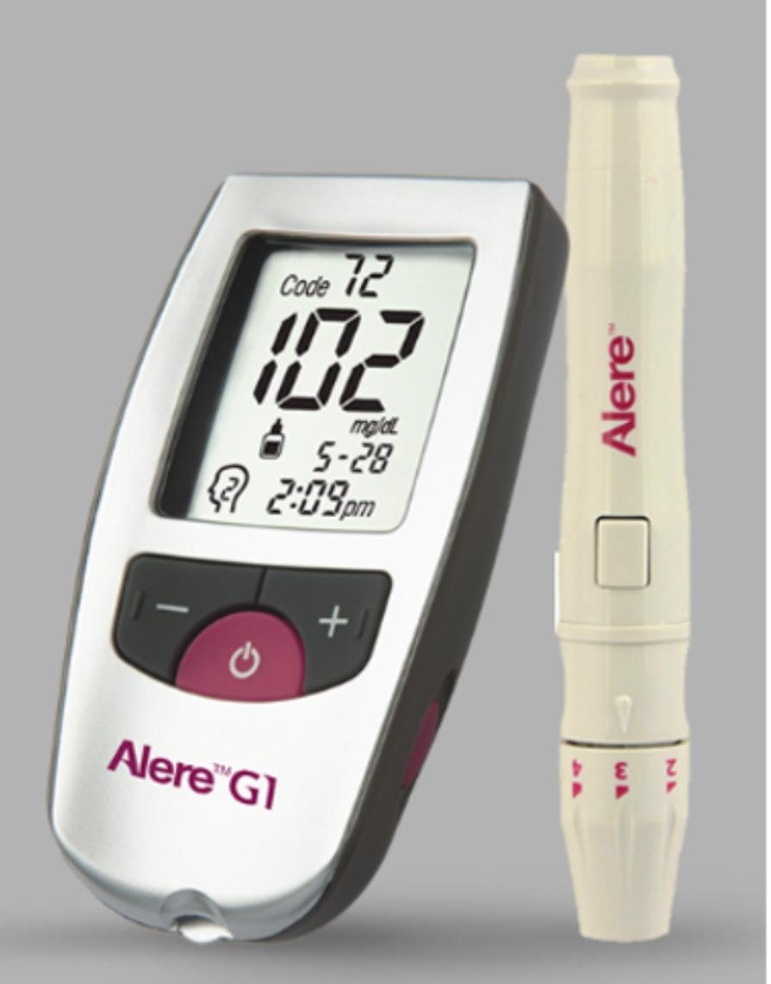
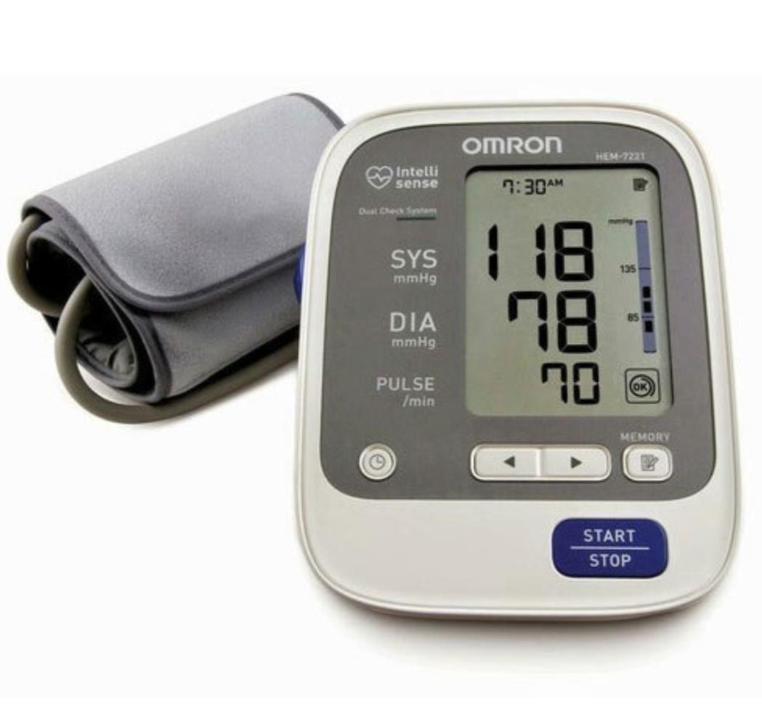
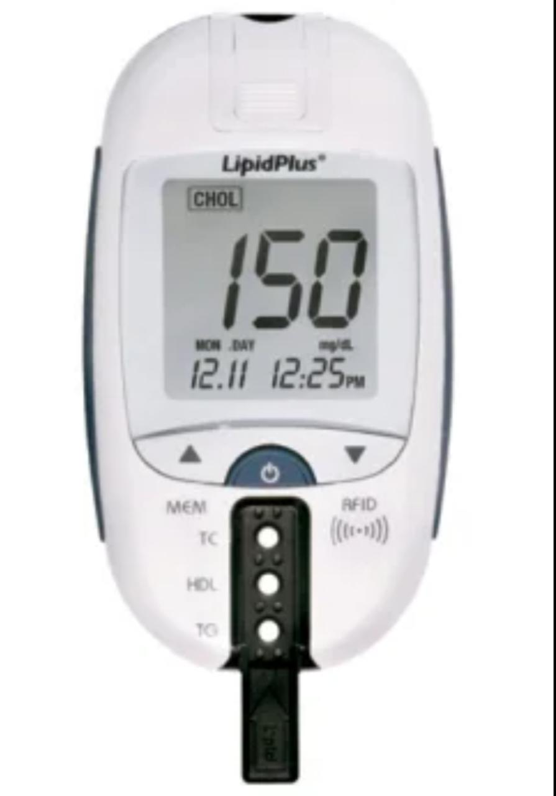
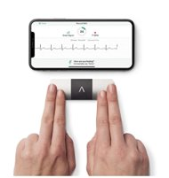
7. REAL LIFE IMPLEMENTATION
To implement this project in real life we need following portable devices.
portable glucometer,
cholesterol meter,
automated BP machine,
portable automated
ECG machine.
Smart phone
Glucometer
Cholesterol meter
Automated BPS
Portable ECG

Slide 12
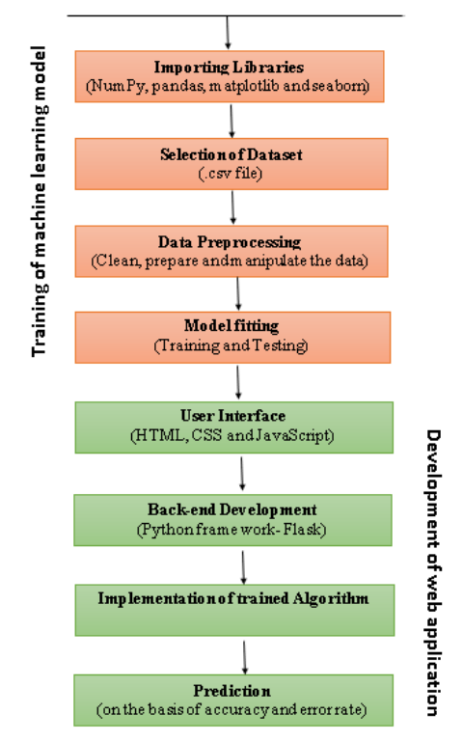
8. PROPOSED SYSTEM
We have developed a web application to serve rural area and home healthcare to early predication of risk of heart disease. Firstly, we have imported the data-set which should be .csv file, after this we have processed the data by selecting attributes and parameters. After that we have trained with different machine learning algorithms. then after we have designed an User interface using HTML, CSS and JavaScript after that we developed backend using a python’s framework flask and added trained machine learning models to backend to predict the risk of heart disease of a patient.
Notes:
Links:
https://unsplash.com/photos/fzOITuS1DIQ

Slide 13
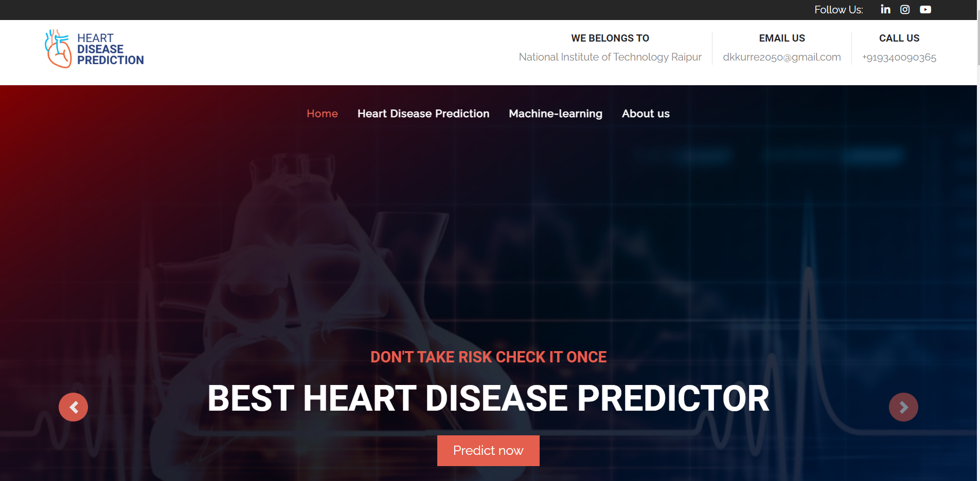
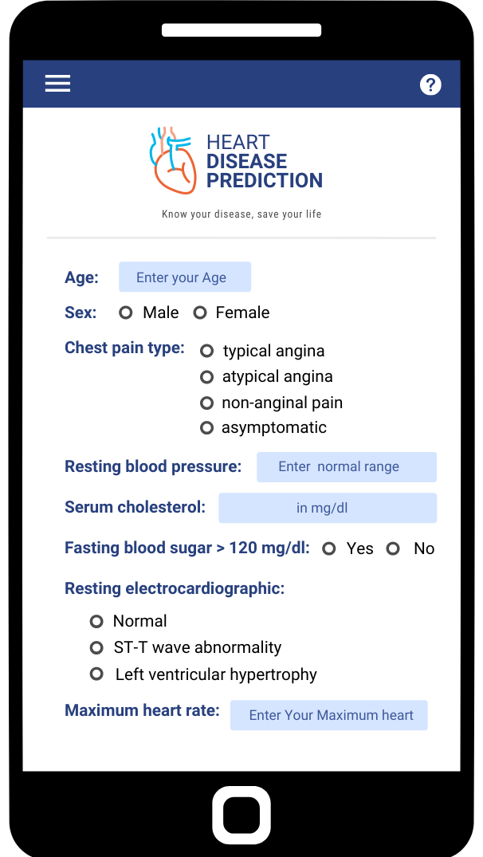
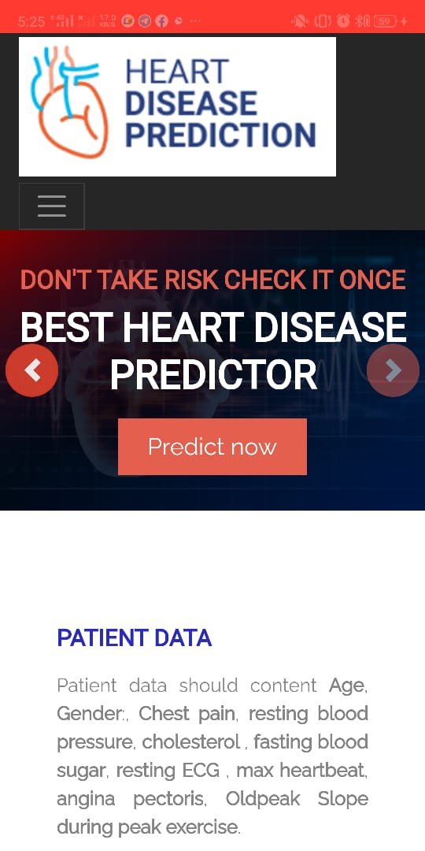
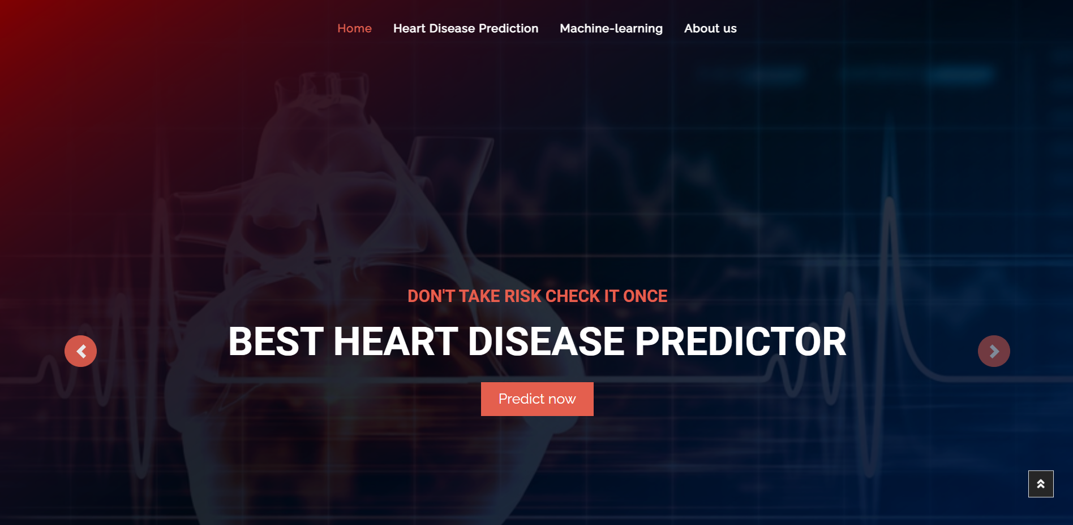
9. Website and Mobile Application
Website Link : https://heart-disease-predication.herokuapp.com/
Mobile App
Notes:
Links:
https://unsplash.com/photos/fzOITuS1DIQ

Slide 14
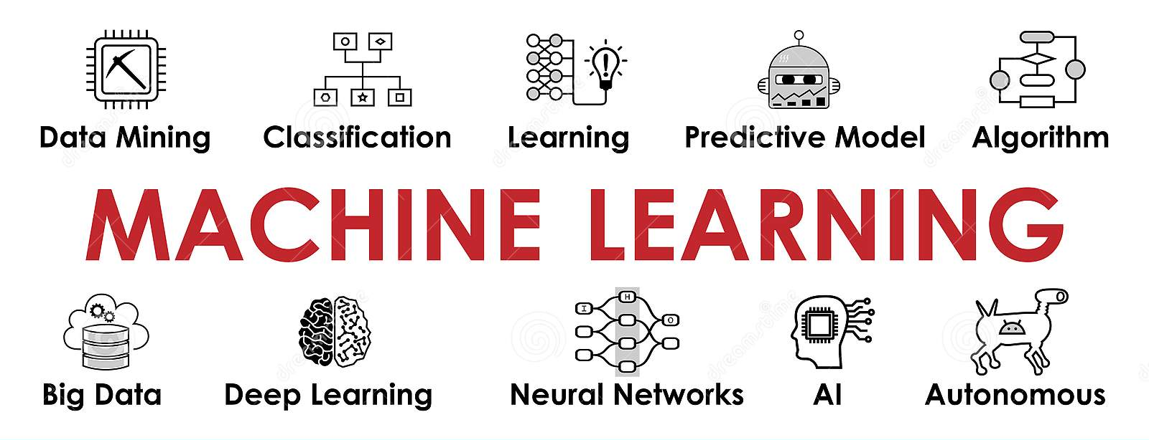
10. MACHINE LEARNING
Machine learning is an application of artificial intelligence that involves algorithms and data that automatically analyses and make decision by itself without any human intervention.
In machine learning method we fed data to model, or a machine and model analyses the data by its own and while learning it improves it’s accuracy by its own experiences and for better accuracy, we need large amount of data.
Notes:
Links:
https://unsplash.com/photos/fzOITuS1DIQ

Slide 15
11. TYPES OF MACHINE LEARNING
MACHINE LEARNING algorithms are trained using three prominent methods.
Supervised Learning
Unsupervised Learning
Reinforcement Learning
MACHINE LEARNING
Supervised Learning
Reinforcement Learning
Unsupervised Learning
Classification
Regression
Clustering
Association
Notes:
Links:
https://unsplash.com/photos/fzOITuS1DIQ

Slide 16
12. ALGORITHM(METHODS)
Total 8 Algorithms(models) have been used for this Heart Disease Prediction.
1
2
3
4
Logistic Regression
Naive Bayes
K-Nearest Neighbour
Decision Tree
5
6
7
8
Random Forest
Support Vector Machine
XG Boost
Stochastic Gradient Descent
Notes:
Links:
https://unsplash.com/photos/fzOITuS1DIQ

Slide 17
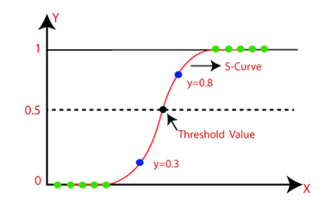
12.1 LOGISTIC REGRESSION
Logistic regression is a supervised learning algorithm used in machine leaning to predict the probability of a binary outcome.
Sigmoid function to map predicted prediction and their probability.
Binary logistic regression , multinomial logistic regression , ordinal logistic regression when dependent variable are categorical then we use logistic regression .
Fig. Logistic Regression
Notes:
Links:
https://unsplash.com/photos/fzOITuS1DIQ

Slide 18
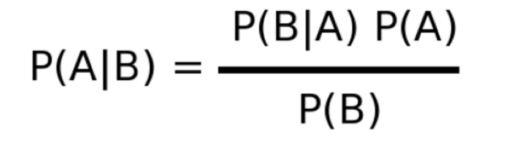
12.2 NAÏVE BAYES
Naïve Bayes classifiers are a collection of classification algorithms based on Bayes’ Theorem. It is not a single algorithm but a family of algorithms where all of them share a common principle, i.e. every pair of features being classified is independent of each other. In this project we have used gaussian NB algorithm.
It is a probabilistic supervised machine learning method used for classification. It is used to determine the probability of hypothesis with prior knowledge. It depends on the conditional probability.
Bayes theorem formula is given as:
Here you can find the complete PPT on NAÏVE BAYES - link
Notes:
Links:
https://unsplash.com/photos/fzOITuS1DIQ

Slide 19
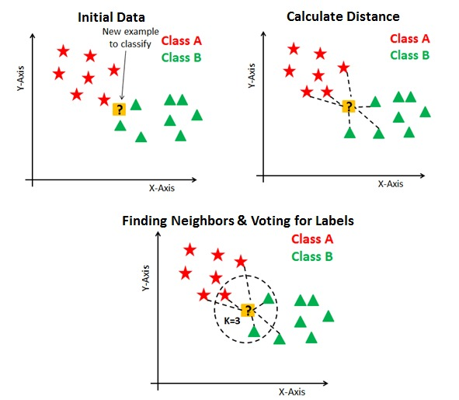
12.3 K-NEAREST NEIGHBOUR
K-NN algorithm is supervised machine learning algorithm that can be used to solve both classification and regression problems.
It assumes the similarity between the new case/data and available cases and put the new case into the category that is most similar to the available categories.
Principle - KNN works by finding the distances between a query and all the examples in the data, selecting the specified number examples (K) closest to the query, then votes for the most frequent label (in the case of classification) or averages the labels (in the case of regression).
The algorithm’s learning is
Instance-based learning
Lazy Learning
Non –Parametric
Here you can find the complete PPT on KNN - link
Fig. K-NEAREST NEIGHBOUR
Notes:
Links:
https://unsplash.com/photos/fzOITuS1DIQ

Slide 20
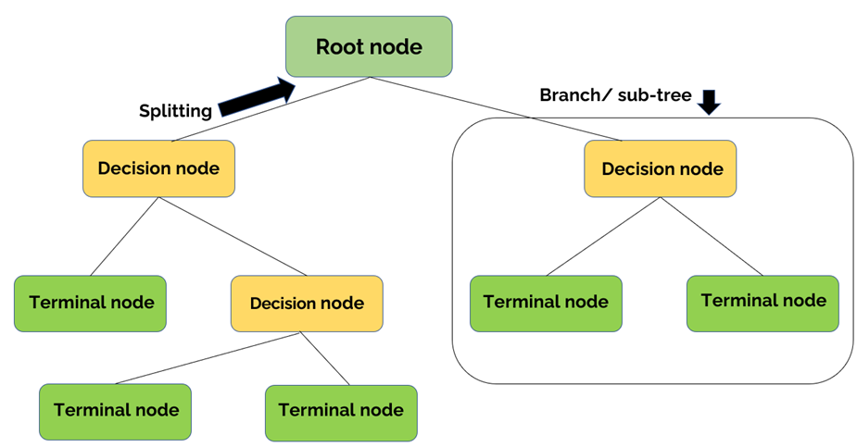
12.4 DECISION TREE
Decision tree is a tree like model of decisions and their possible consequences, a way of breaking down of a complicated situation to easier to understand scenarios.
A decision tree is a flowchart- like structure in which each internal node represents a “test” on an attribute, each branch represents the outcome of the test, and each leaf node represent a class label (decision taken after computing all attributes). The path from root to leaf represent classification rules.
There are mainly two algorithms to control
the splitting conditions in a decision tree.
Entropy
Information gain
Gini index
Here you can find the complete PPT on DECISION TREE - link
Fig. DECISION TREE
Notes:
Links:
https://unsplash.com/photos/fzOITuS1DIQ

Slide 21
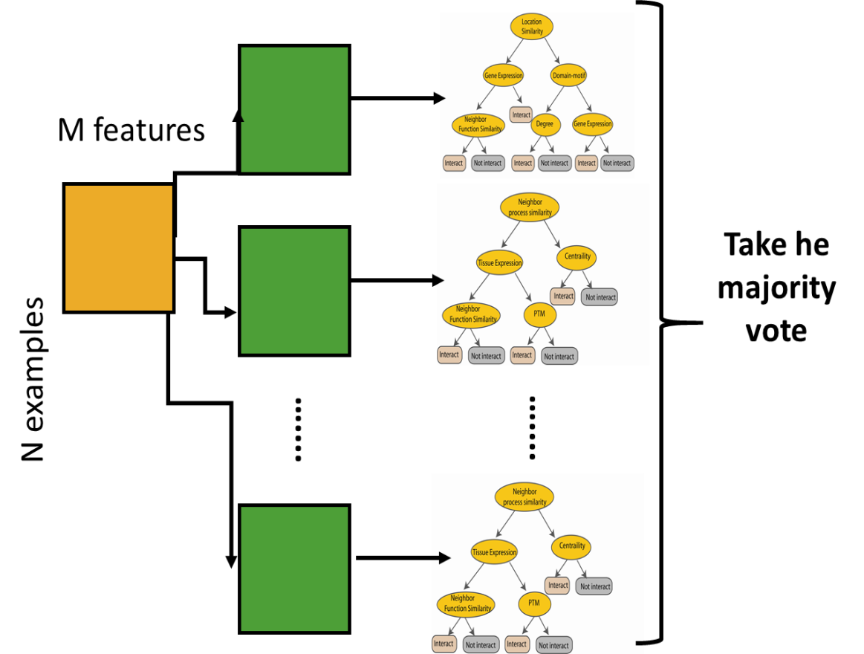
12.5 RANDOM FOREST
It’s an Ensemble learning technique
Basic element of Random Forest is
Decision trees.
So, we can say Random forest classifier, is an extension to bagging which uses multiple decision tress to predict the output.
Bagging = bootstrap + aggregation
Bootstrapping means randomly draw datasets with replacement from the training data, each sample the same size as the original training set.
Here you can find the complete PPT on RANDOM FOREST: LINK
Fig. RANDOM FOREST
Notes:
https://unsplash.com/photos/fzOITuS1DIQ

Slide 22
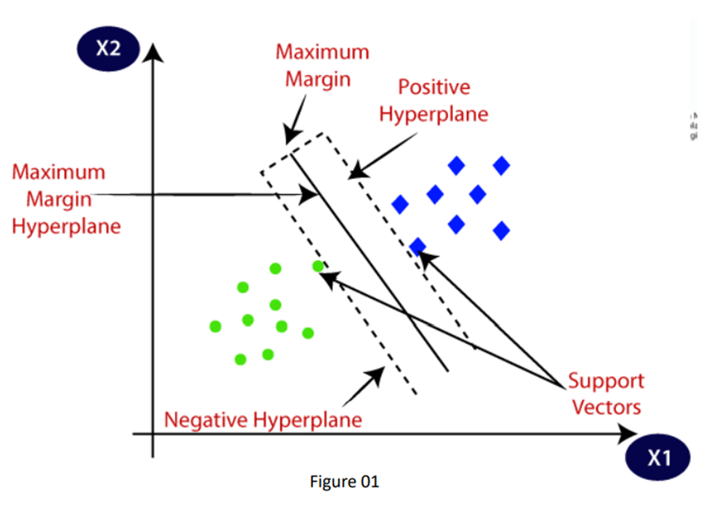
12.6 SUPPORT VECTOR MACHINE
SVM algorithm create the best line or decision boundary that can segregate n-dimensional space into classes so that we can easily put the new data point in the correct category. This best decision boundary is called a hyperplane. The data points or vectors that are the closest to the hyperplane and which affect the position of the hyperplane are termed as Support Vector.
1. Types of Support Vector Machine:
Linear SVM: used for linearly separable data.
Non-linear SVM: used for non-linearly separated data
2. Tuning Parameters
Margin: distance between the vectors and the hyperplane.
Regularization: prevent the model from overfitting.
Gamma: gamma is a parameter for non-linear hyperplanes.
Kernel: mathematical functions for transforming data.
3. Pros & Cons of SVM: effective in high dimensional spaces but
Takes higher time for large data set.
4. Applications: Face detection, classification of images,
text and hypertext categorization
Here you can find the complete PPT on SVM- link
Fig. SUPPORT VECTOR MACHINE
Notes:
Links:
https://unsplash.com/photos/fzOITuS1DIQ

Slide 23
12.7 XG BOOST
XG Boost is an implementation of Gradient Boosted decision trees. This library was written in C++. It is a type of Software library that was designed basically to improve speed and model performance. It has recently been dominating in applied machine learning. XG Boost models majorly dominate in many Kaggle Competitions.
In this algorithm, decision trees are created in sequential form. Weights play an important role in XG Boost. Weights are assigned to all the independent variables which are then fed into the decision tree which predicts results. Weight of variables predicted wrong by the tree is increased and these the variables are then fed to the second decision tree.
These individual classifiers/predictors then ensemble to give a strong and more precise model. It can work on regression, classification, ranking, and user-defined prediction problems.
XG Boost Features: The library is laser-focused on computational speed and model performance, as such, there are few frills.
Three main forms of gradient boosting are supported:
Gradient Boosting
Stochastic Gradient Boosting
Regularized Gradient Boosting
Notes:
Links:
https://unsplash.com/photos/fzOITuS1DIQ

Slide 24
12.8 STOCHASTIC GRADIENT DESCENT
Stochastic gradient descent is an optimization algorithm often used in machine learning applications to find the model parameters that correspond to the best fit between predicted and actual outputs. It’s an inexact but powerful technique.
Stochastic gradient descent is widely used in machine learning applications. Combined with back propagation, it’s dominant in neural network training applications.
Gradient descent is an iterative algorithm, that starts from a random point on a function and travels down its slope in steps until it reaches the lowest point of that function.
Stochastic gradient descent (often abbreviated SGD) is an iterative method for optimizing an objective function with suitable smoothness properties (e.g. differentiable or sub differentiable). It can be regarded as a stochastic approximation of gradient descent optimization, since it replaces the actual gradient (calculated from the entire data set) by an estimate thereof (calculated from a randomly selected subset of the data).
Especially in high-dimensional optimization problems this reduces the computational burden, achieving faster iterations in trade for a lower convergence rate.
Notes:
Links:
https://unsplash.com/photos/fzOITuS1DIQ

Slide 25
13. ADVANTAGES AND DRAWBACKS
ADVANTAGES
Early prediction of heart disease can be done.
The cost of medication will be minimized.
Better performance.
DRAWBACKS
Accuracy Issues because a computerized system alone does not ensure accuracy.
The system is not fully automated, it needs data from user for full diagnosis.
We need more data to accurately predict heart disease .
Notes:
Links:
https://unsplash.com/photos/fzOITuS1DIQ

Slide 26
14. CONCLUSION
Different machine learning algorithms have been learnt and we discovered how several factors influence cardiovascular disease (CVD).
We picked eight algorithms to test on a data set, and the results were excellent, and the methods were quite accurate in predicting heart disease.
Some of the methods have low accuracies ,to improve accuracy, we hope to require more data set because 1189 instances of data set are not sufficient to do an excellent job.
In the future, We will try to improve our machine learning model by adding additional attributes so that we can precisely predict heart disease.
We'll attempt to create a web application that we can use in real life.
Notes:
Links:
https://unsplash.com/photos/fzOITuS1DIQ

Slide 27
15. RESOURCES
https://www.ahajournals.org/doi/full/10.1161/CIRCULATIONAHA.114.008729
https://www.girodmedical.eu/colson-cardiopocket-cms-8-single-channel-portable-ecg.html
https://www.who.int/health-topics/cardiovascular-diseases#tab=tab_1
https://www.who.int/india/health-topics/cardiovascular-diseases
https://tools.acc.org/ascvd-risk-estimator-plus/#!/calculate/estimate/
Notes:
Links:
https://unsplash.com/photos/fzOITuS1DIQ

Slide 28
THANK YOU

